Slide 1
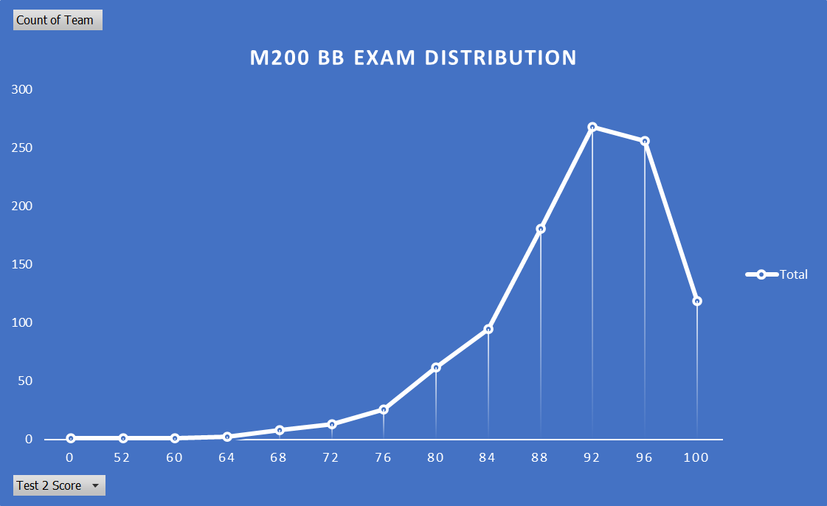
Score | Count
0 | 1
52 | 1
60 | 1
64 | 2
68 | 8
72 | 13
76 | 26
80 | 62
84 | 95
88 | 181
92 | 268
96 | 256
100 | 119
Grand Total | 1033

Slide 2
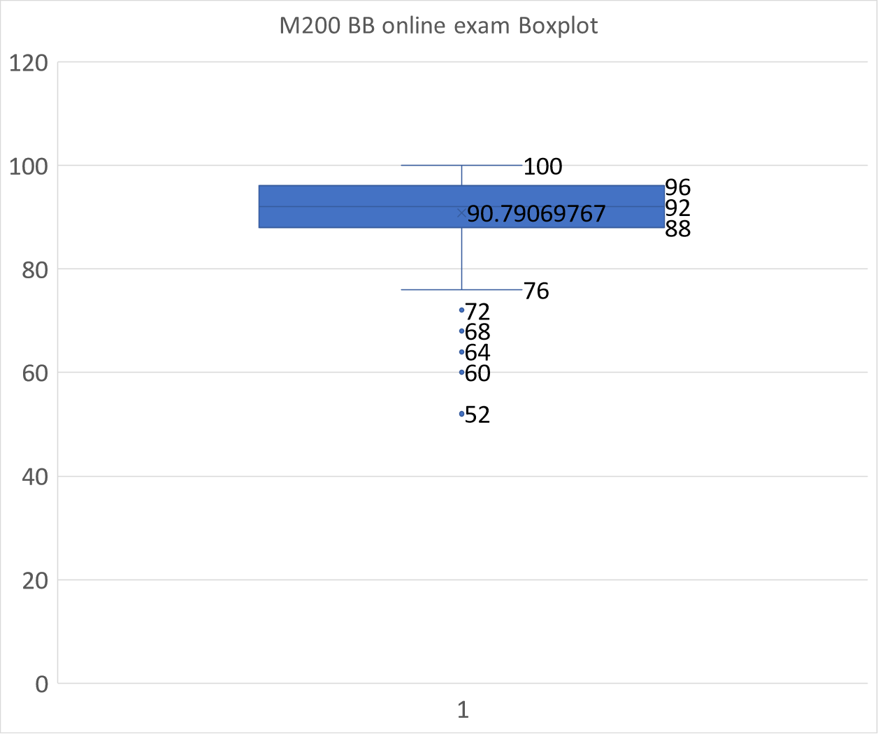
Mean | 90.7907
Standard Deviation | 6.873919
Min | 52
Mode | 92
Max | 100
Upper quartile | 96
Lower Quartile | 88
IQR | 8

